Slide 1


BCS786 - Phase II - Project Review 2
Gopalan College of Engineering & Management
Department of Computer Science
Project Title: Explainable CNN–BiLSTM Based EEG Signal
Analysis System for Epileptic Seizure Detection
Under the Guidance of:
Dr. Swathi Y,
Head, Department of CSE,
GCEM, Bangalore.
Team Members:
DIVYASHREE C (1GD23CS030)
2. JANANI B M (1GD23CS040)

Slide 2
Contents
Introduction
Problem Statement
Objective
Literature Survey
Proposed Method
System Architecture
Experimental Setup
Model Architecture and Training
Results
Visual Results/Demo
State-of-the-Art Comparison
Contribution to the Work
Advantages and Limitations
Future Scope and Conclusion
References

Slide 3
Introduction
Epileptic seizures are abnormal electrical activities in the brain that can be observed through EEG signals.
EEG recordings contain complex temporal patterns that make manual seizure identification time-consuming.
Deep learning can automatically learn discriminative features from EEG signals.
The proposed system combines CNN for feature extraction and Bi-LSTM for temporal sequence learning.
The system incorporates Grad-CAM-based explainability to visualize signal features contributing to model predictions.
The developed system is an academic research prototype and is not intended for clinical diagnostic decision-making.

Slide 4
Problem Statement
Manual analysis of long-duration EEG recordings is time-consuming and requires expert interpretation.
EEG signals contain complex temporal patterns that are difficult to identify consistently.
Traditional approaches may require handcrafted feature extraction.
CNNs are effective at extracting local signal features but have limited ability to model temporal dependencies alone.
Deep learning predictions can be difficult to interpret without an explainability mechanism.
Therefore, an automated system is required that combines EEG feature extraction, temporal learning, seizure detection, and model interpretability.

Slide 5
Objective
Develop an automated EEG-based seizure detection system.
Preprocess multi-channel EEG recordings using a consistent signal-processing pipeline.
Segment EEG recordings into fixed-length windows.
Use CNN layers for EEG feature extraction.
Use Bi-LSTM layers to learn temporal dependencies.
Generate seizure probabilities for individual EEG windows.
Detect temporal seizure events from window-level predictions.
Incorporate Grad-CAM for model prediction visualization.
Provide an interactive interface for EEG analysis and result visualization.

Slide 6
Literature Survey
Sl. No. | Author / Year | Proposed Method | Dataset | Performance | Pros | Cons
1 | Dhondiyal et al., 2025 | GNN + CNN + LSTM | EEG Dataset | High Accuracy | Captures Spatial + Temporal Features | Complex, No Explainability
2 | K. Sharma et al., 2026 | CNN–LSTM Real-Time Seizure Detection | EEG Dataset | Accuracy, Latency | Real-Time System | High Computation
3 | A. Kumar et al., 2025 | Hybrid CNN–LSTM | CHB-MIT | ~98.5% | Spatial + Temporal Learning | No Explainability
4 | Z. Li et al., 2025 | 1D CNN–LSTM | EEG Bands | High Accuracy | Good Feature Extraction | Black-Box
5 | M. Rahman et al., 2026 | CNN–LSTM Multimodal | Multimodal Dataset | High Performance | Multi-Signal Learning | Complex
6 | S. Patel et al., 2025 | CNN–LSTM–GRU | EEG Dataset | High Accuracy | Strong Sequence Modeling | High Complexity
7 | Y. Zhang et al., 2026 | CNN–BiLSTM | EEG Dataset | High Accuracy | Bidirectional Learning | Black-Box

Slide 7
Literature Survey
Sl. No. | Author / Year | Proposed Method | Dataset | Performance | Pros | Cons
8 | R. Patel et al., 2024 | Explainable CNN–LSTM (SHAP) | EEG Dataset | Accuracy + XAI | Interpretability | Extra Computation
9 | J. Singh et al., 2026 | Deep Learning Survey | Multiple Datasets | Comparative | Covers All Models | No Implementation
10 | H. Khan et al., 2024 | ML vs DL Comparison | EEG Dataset | ~97% | Comparative Study | DL Complexity
11 | Einizade et al., 2023 | Attentive Deep Multi-View Network | TUH EEG | F1 ≈ 81% | Explainable, Cross-Subject Learning | Complex Model
12 | Mir et al., 2023 | DCAE + CNN + BiLSTM | CHB-MIT + Clinical Dataset | Accuracy ≈ 99.8% | Robust, High Accuracy | High Computation
13 | Abdallah et al., 2023 | 1D CNN + LSTM + Self-Attention | CHB-MIT + UCI | Accuracy ≈ 97.9% | Cross-Subject, Attention-Based | Computational Complexity
14 | Murugan & Kameswaran, 2024 | CNN + Explainable AI (SHAP) | EEG Datasets | High Accuracy | Explainability, Feature Analysis | Extra Computation
15 | Kashefi Amiri et al., 2025 | DWT + 1D CNN-LSTM | CHB-MIT, BONN, TUSZ | Accuracy ≈ 96.94% | Effective Feature Extraction | Preprocessing Complexity

Slide 8
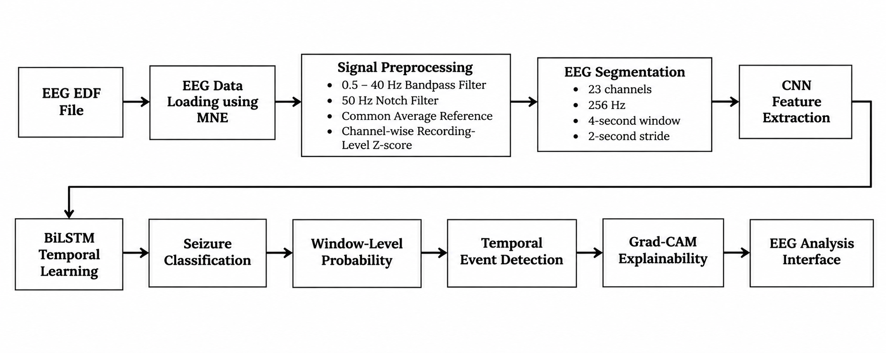
Proposed Method

Slide 9
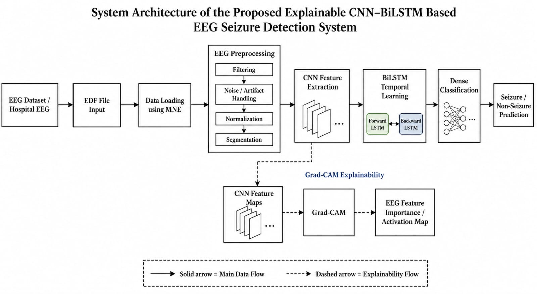
System Architecture

Slide 10
Experimental Setup
Dataset: CHB-MIT Scalp EEG Database – PhysioNet
24 patients
683 EDF recordings
652 usable canonical 23-channel recordings
141 seizure recordings
542 non-seizure recordings
Sampling frequency: 256 Hz
Patient-Independent Split
Training – 11 patients:
chb04, chb08, chb09, chb11, chb14, chb17, chb18, chb20, chb21, chb22, chb23
Validation – 3 patients:
chb05, chb07, chb16
Testing – 7 patients:
chb01, chb02, chb03, chb06, chb10, chb13, chb19

Slide 11
Model Architecture & Training
CNN:
Conv2D – 64 filters, kernel 1×7
Conv2D – 128 filters, kernel 1×5
Conv2D – 256 filters, kernel 1×3
Batch Normalization
ReLU activation
Max Pooling
Dropout
Bi-LSTM:
Bi-LSTM Layer 1 – 128 hidden units
Bi-LSTM Layer 2 – 64 hidden units
Bidirectional temporal learning
Classifier:
Dense – 64 units
Dropout
Binary output
Training Configuration:
Optimizer: AdamW
Learning rate: 1 × 10⁻⁴
Weight decay: 1 × 10⁻⁴
Batch size: 64
Seed: 42
Gradient clipping: 5.0
Hard-negative mining
GPU-based training
Total Model Parameters: 6,476,673

Slide 12
Results
Held-Out Test Set – Final Run5 Model
Metric | Result
ROC-AUC | 83.57%
PR-AUC | 75.39%
Sensitivity | 11.03%
Specificity | 99.97%
Precision | 99.26%
F1-Score | 19.85%

Slide 13
Results
Confusion Matrix
 | Predicted Negative | Predicted Positive
Actual Negative | TN: 3,644 | FP: 1
Actual Positive | FN: 1,081 | TP: 134
Operating Point:
Threshold: 0.50
Persistence: 1 window
Result Interpretation:
The model demonstrates very high specificity and precision, while sensitivity remains a major limitation on the held-out test cohort.

Slide 14
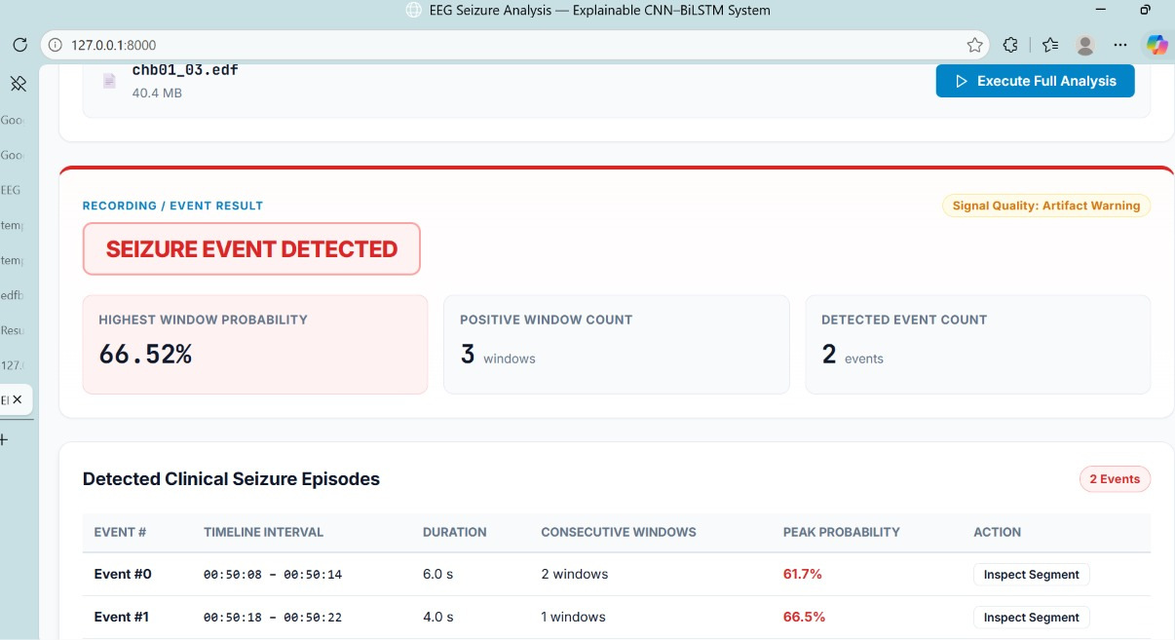
Visual Results / Demo
1. EEG Recording Input
EDF upload
256 Hz / 23-channel indication
2. Recording/Event Result
Highest Window Probability
Positive Window Count
Detected Event Count

Slide 15
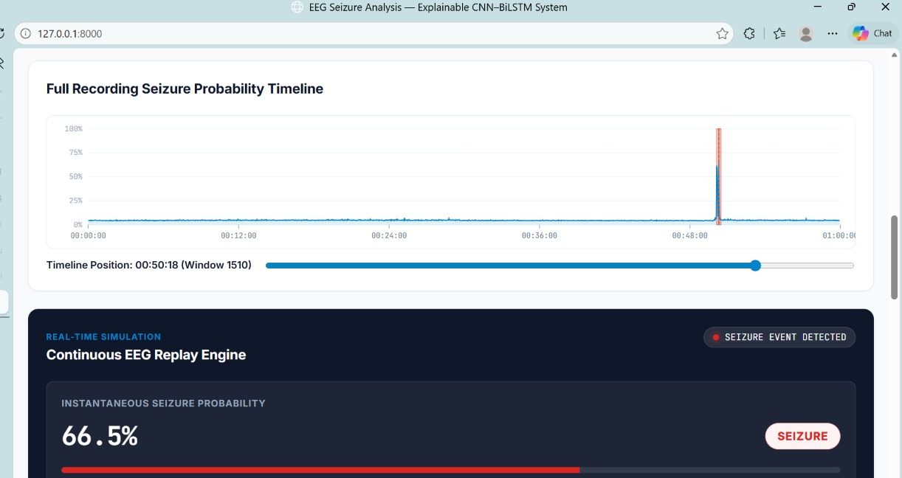
Visual Results / Demo
3. Full Recording Seizure Probability Timeline
Window-level probability curve
Detected event regions

Slide 16
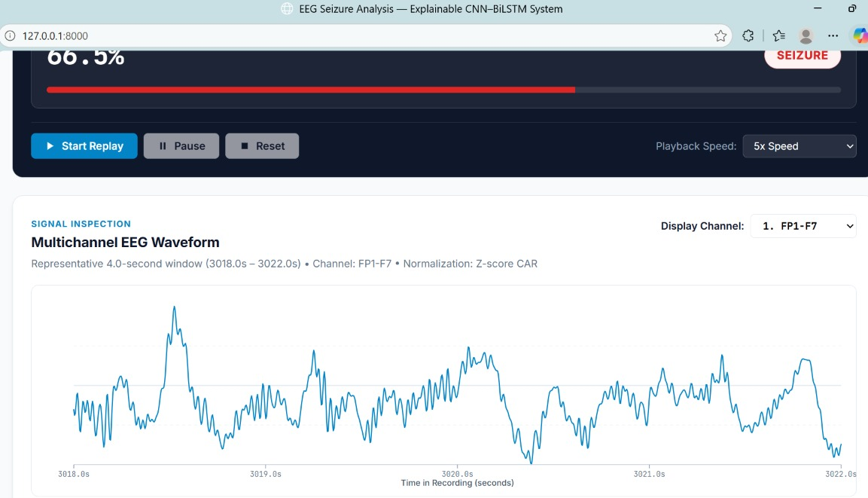
Visual Results / Demo
4. Multichannel EEG Waveform
23-channel EEG signal visualization

Slide 17
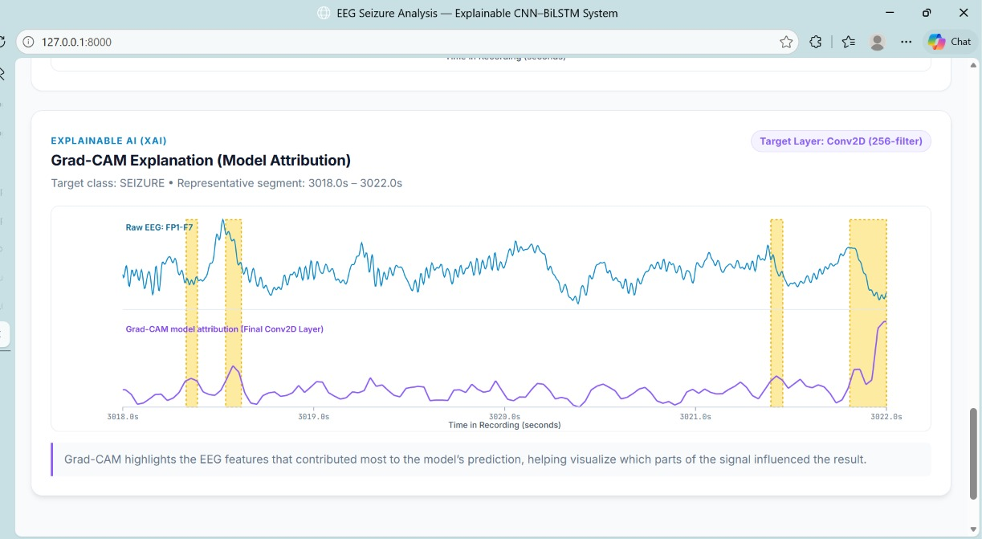
Visual Results / Demo
5. Grad-CAM Visualization
Grad-CAM highlights the EEG features that contributed most to the model's prediction, helping visualize which parts of the signal influenced the result.

Slide 18
State-of-the-Art Comparison
Comparison of Existing Approaches and Proposed System
Approach | Main Characteristics
Traditional ML | Requires handcrafted EEG features
CNN-based | Local feature extraction
CNN-LSTM | Feature extraction with temporal learning
Hybrid deep learning | Combines multiple learning components
Proposed CNN-BiLSTM | CNN feature extraction + bidirectional temporal learning + explainability
Key Aspects of the Proposed System
Patient-independent evaluation
CNN + BiLSTM architecture
Temporal event detection
Grad-CAM visualization
Interactive EEG analysis interface

Slide 19
Contribution to the Work
Developed a CNN–BiLSTM based EEG seizure detection system .
Implemented a standardized multi-channel EEG preprocessing pipeline.
Used fixed-length overlapping EEG windows for model inference.
Incorporated hard-negative mining and focal loss during training.
Implemented patient-independent train/validation/test partitioning.
Added temporal event detection from window-level predictions.
Integrated Grad-CAM-based model explainability.
Developed an interactive EEG analysis interface for visualizing predictions and signal information.

Slide 20
Advantages & Limitations
    Advantages:
    Automated EEG analysis
    Learns features directly from EEG signals
    Captures temporal dependencies using BiLSTM
    Patient-independent evaluation
    Provides window-level probabilities
      Provides temporal event visualization
    Includes model explainability
    Interactive analysis interface
    Limitations:
    Sensitivity on the held-out test cohort is currently low.
    False negatives remain significant.
    Evaluation is based on the CHB-MIT dataset.
    External clinical validation has not been performed.
    Grad-CAM provides model attribution, not clinical interpretation.
    The system is a research prototype and is not clinically approved or validated.

Slide 21
Future Scope
Evaluate the model on larger and more diverse EEG datasets.
Validate performance using external hospital EEG recordings.
Improve sensitivity while maintaining high specificity.
Explore patient-adaptive and cross-dataset approaches.
Investigate additional explainability techniques.
Optimize inference for real-time deployment.
Develop a more comprehensive clinician-oriented interface.
Perform prospective clinical validation before considering clinical use.

Slide 22
Conclusion
A CNN–BiLSTM based EEG seizure detection system was developed using the CHB-MIT dataset.
The system performs EEG preprocessing, segmentation, deep feature extraction, temporal learning, seizure classification, and event detection.
Grad-CAM provides visualization of model feature contributions.
The final Run5 model achieved 83.57% ROC-AUC and 99.97% specificity on the held-out test cohort.
However, sensitivity remains a key limitation, indicating the need for further research before clinical application.
The developed system serves as an explainable academic research prototype for EEG signal analysis.

Slide 23
References
Base Paper:
  Optimized Hybrid GNN-CNN-LSTM Model for Reliable Epileptic Seizure Detection Using EEG Signals - Dhondiyal, S. et al., IEEE ICCES, 2025.
  Base Paper Link : Optimized Hybrid GNN-CNN-LSTM Model for Reliable Epileptic Seizure Detection Using EEG Signals | IEEE Conference Publication | IEEE Xplore
2. Dataset Source: CHB-MIT Scalp EEG Database – PhysioNet
Dataset Source Link: CHB-MIT Scalp EEG Database
3. Other References:
  Sharma, K. et al., “CNN–LSTM Based Real-Time Epileptic Seizure Detection Using EEG Signals,” 2026.
  Kumar, A. et al., “Hybrid CNN–LSTM Model for Epileptic Seizure Detection Using EEG Signals,” 2025.
  Zhang, Y. et al., “CNN–BiLSTM Model for EEG Signal Classification,” 2026.
  Patel, R. et al., “Explainable CNN–LSTM Model for EEG-Based Seizure Detection Using SHAP,” 2024.

Slide 24
Thank You

